Slide 1
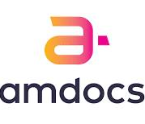
Docker Project
Karishma Sayyad
200120

Slide 2

Contents
Spring boot
Maven
Selenium
Git Hub
Docker
Docker Hub

Slide 3

Introduction
Spring Boot:
Spring Boot is an open-source, microservice-based Java web framework offered by Spring. Spring Boot automatically configures your application based on the dependencies.
Maven:
Maven is a popular open-source build tool that the Apache Group developed for building, publishing, and deploying several projects. Maven is written in Java and is used to create projects written in C#, Scala, Ruby, and so on. The tool is used to build and manage any Java-based project.
Selenium:
Selenium is an open-source, automated testing tool used to test web applications across multiple browsers. It's primarily built in Java and supports several browsers and programming languages.
Git Hub:
GitHub is a code hosting platform for version control and collaboration. It lets you and others work together on projects from anywhere. This tutorial teaches you GitHub essentials like repositories, branches, commits, and pull requests.
Docker:
Docker is an open platform for developing, shipping, and running applications. Docker enables you to separate your applications from your infrastructure so you can deliver software quickly.
Docker Hub:
Docker Hub is a hosted repository service provided by Docker for finding and sharing container images with your team.

Slide 4
Spring Initializr

Slide 5
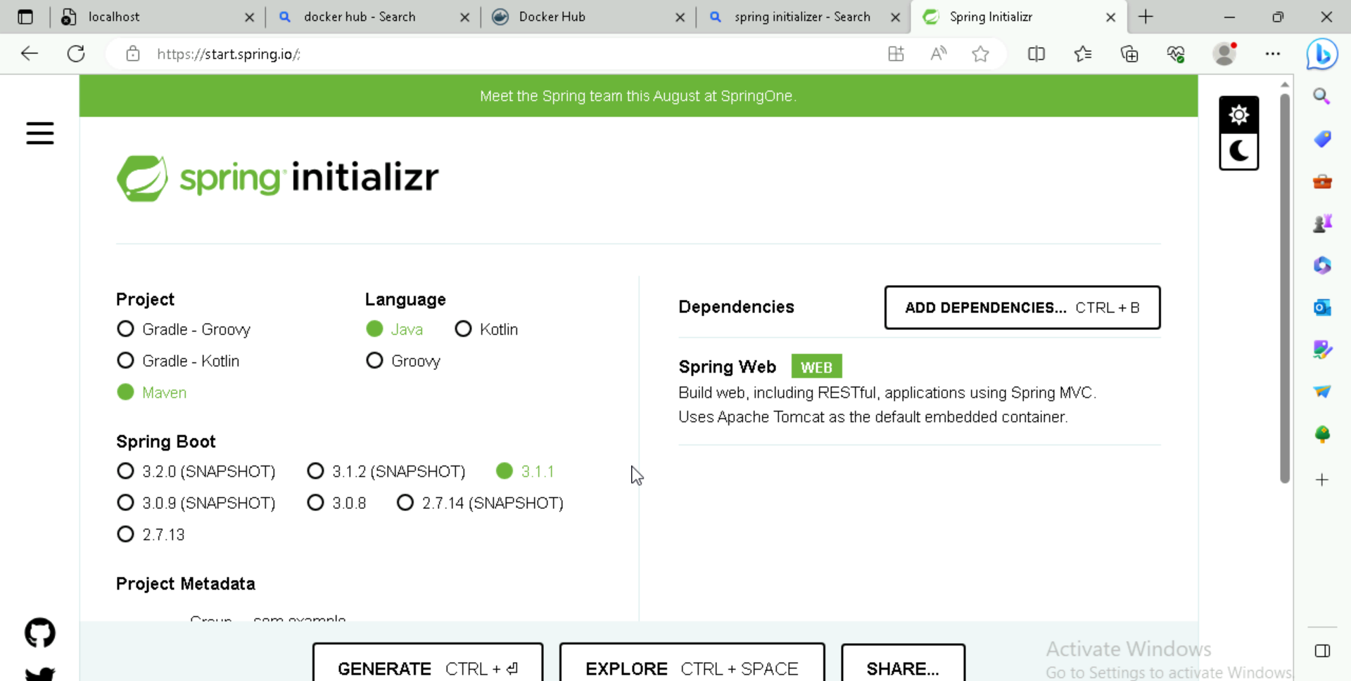

Slide 6
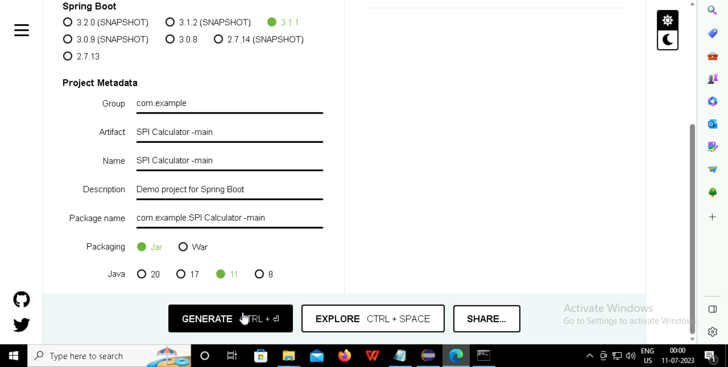

Slide 7
ECLIPSE

Slide 8
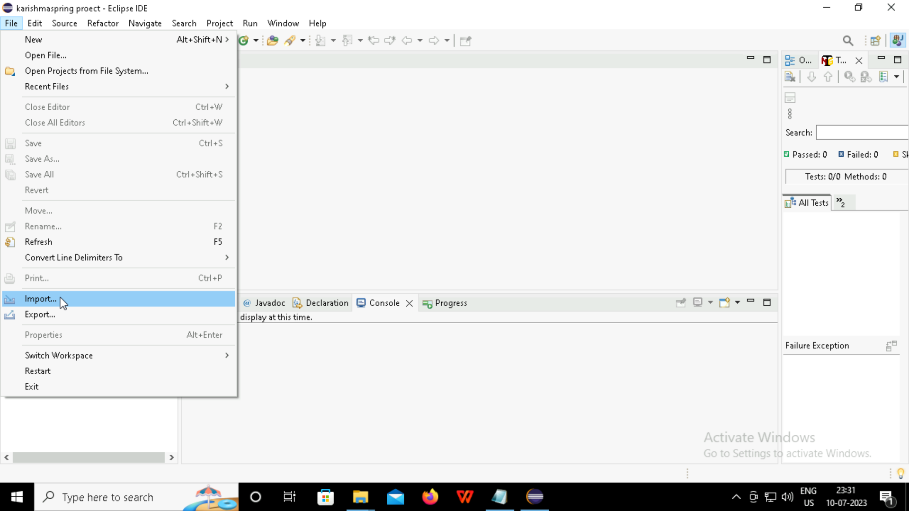

Slide 9
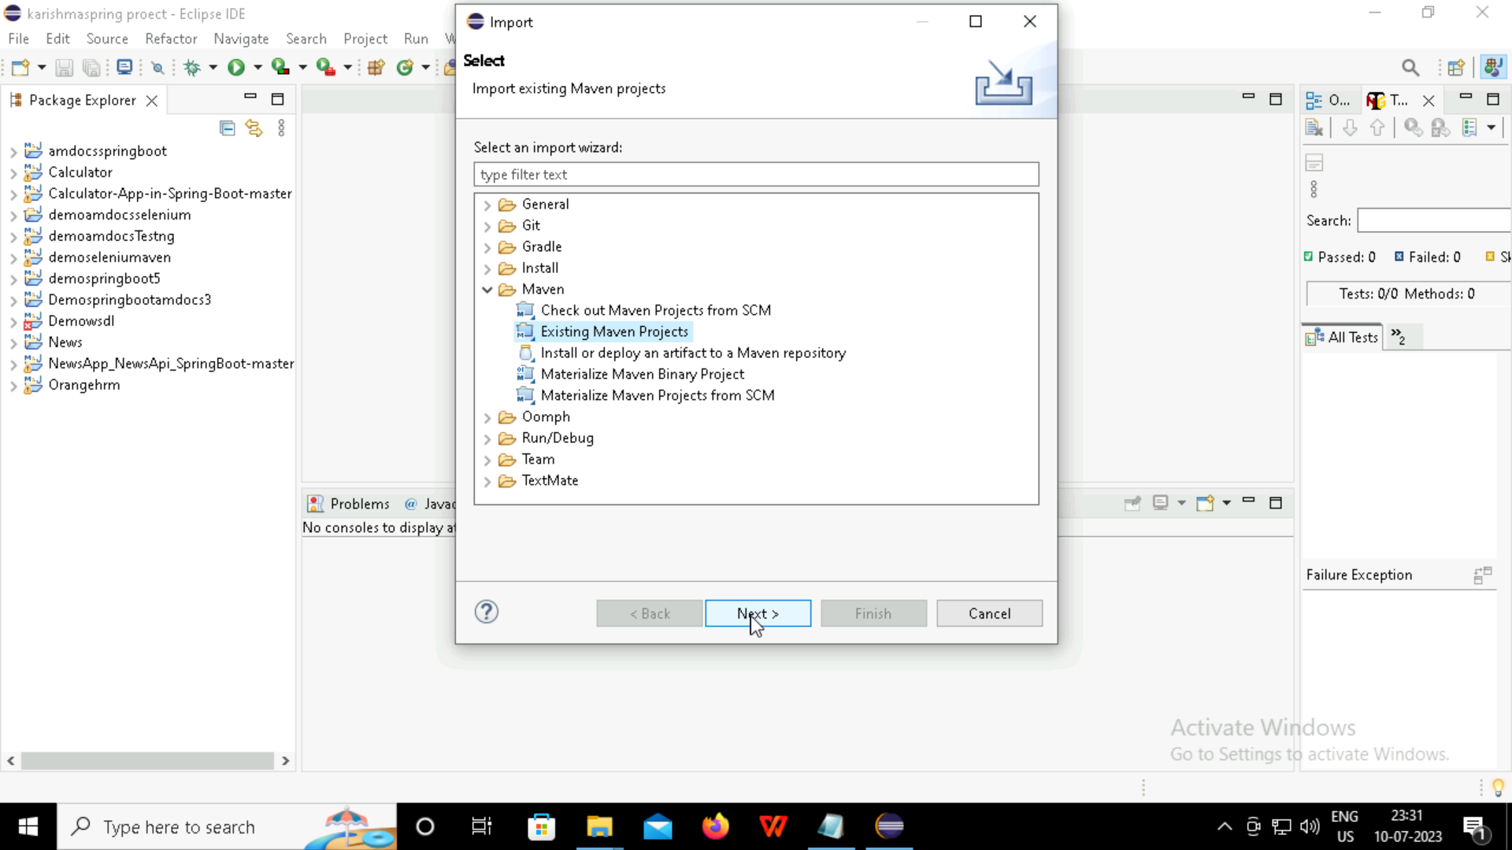

Slide 10
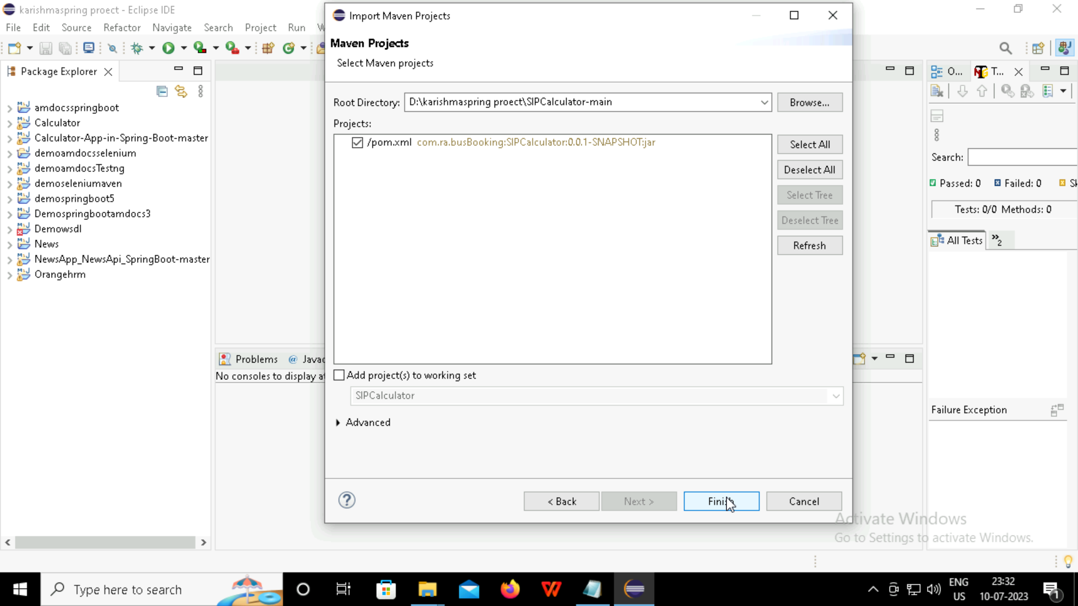

Slide 11
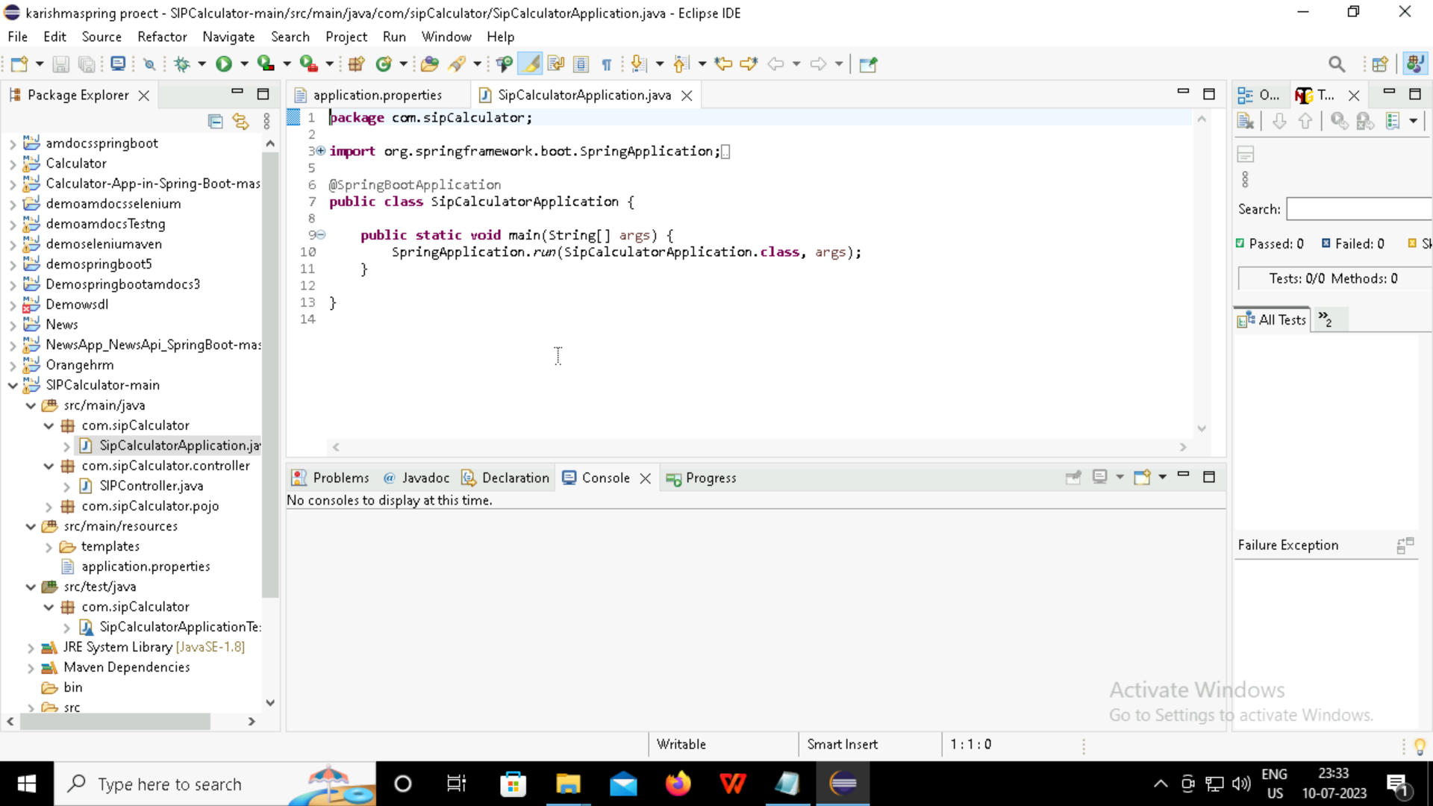

Slide 12
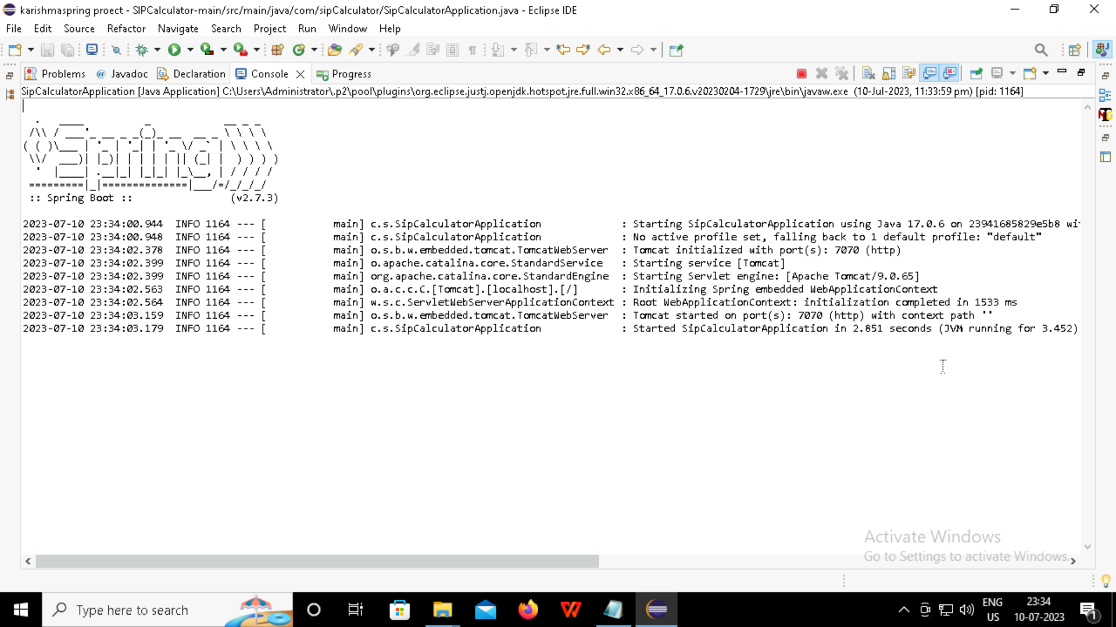

Slide 13
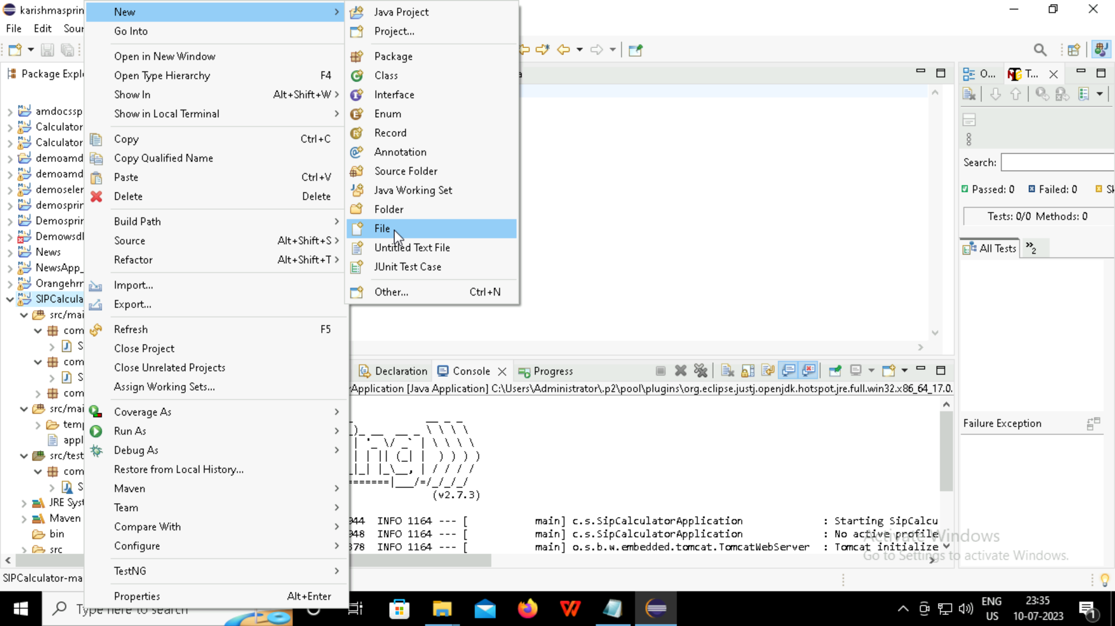

Slide 14
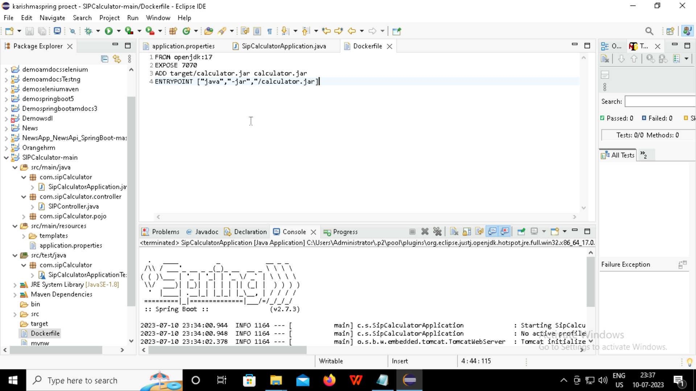

Slide 15
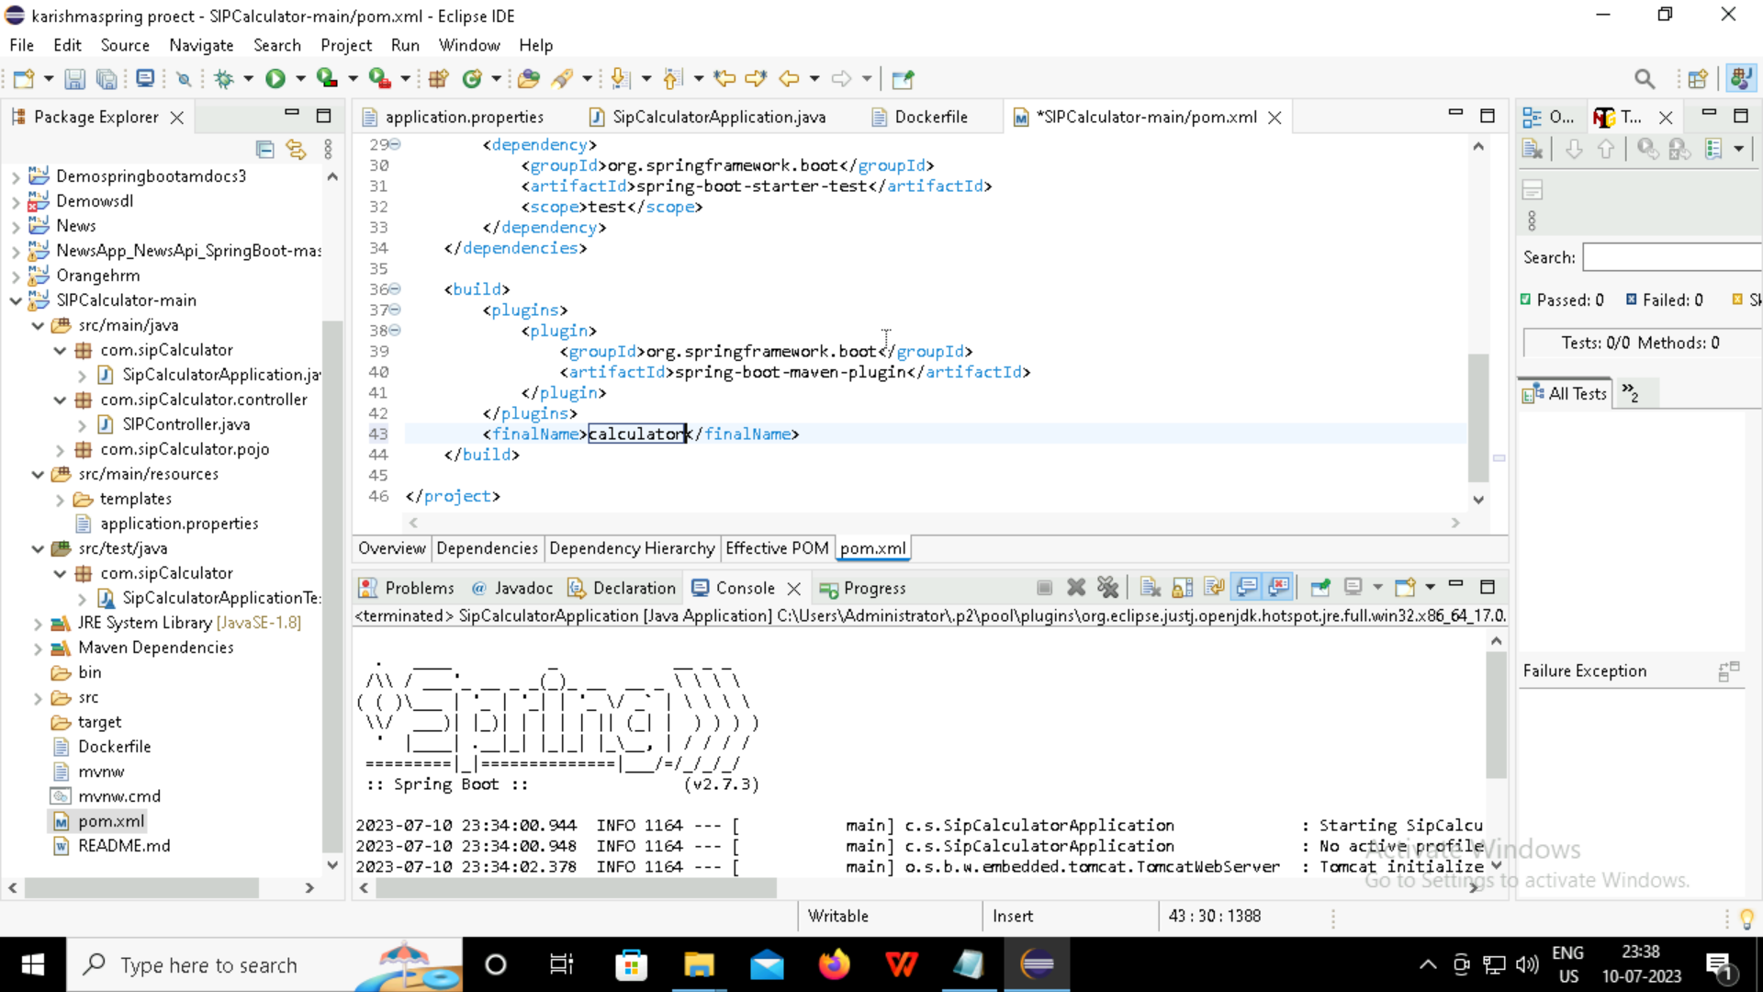

Slide 16
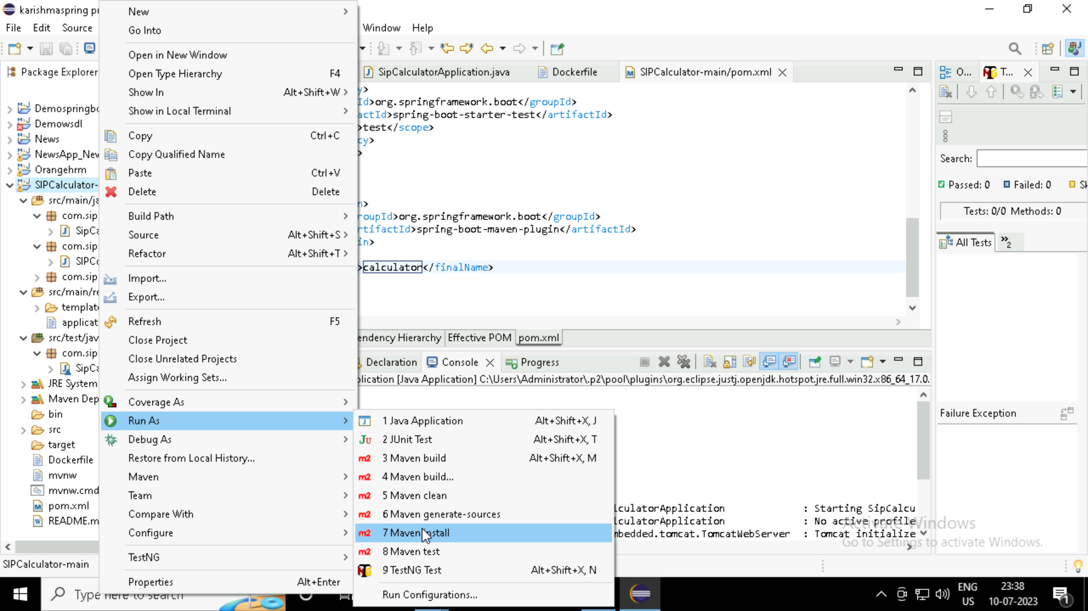

Slide 17
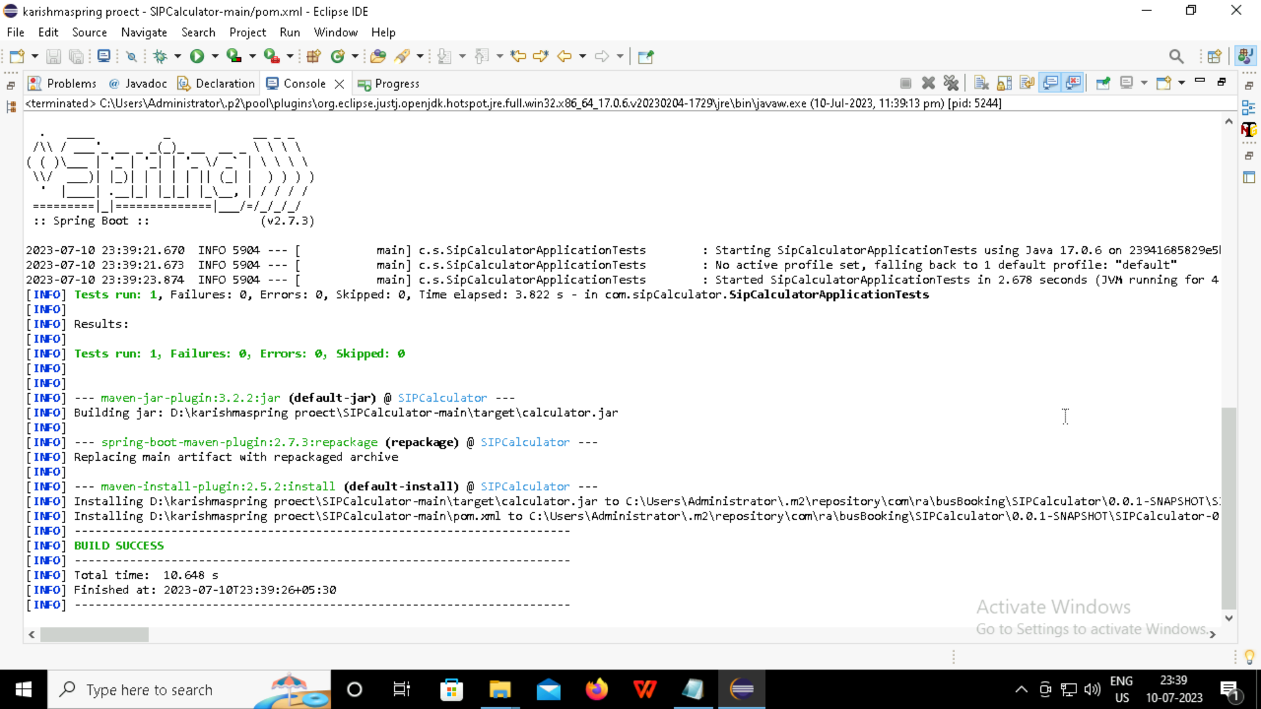

Slide 18
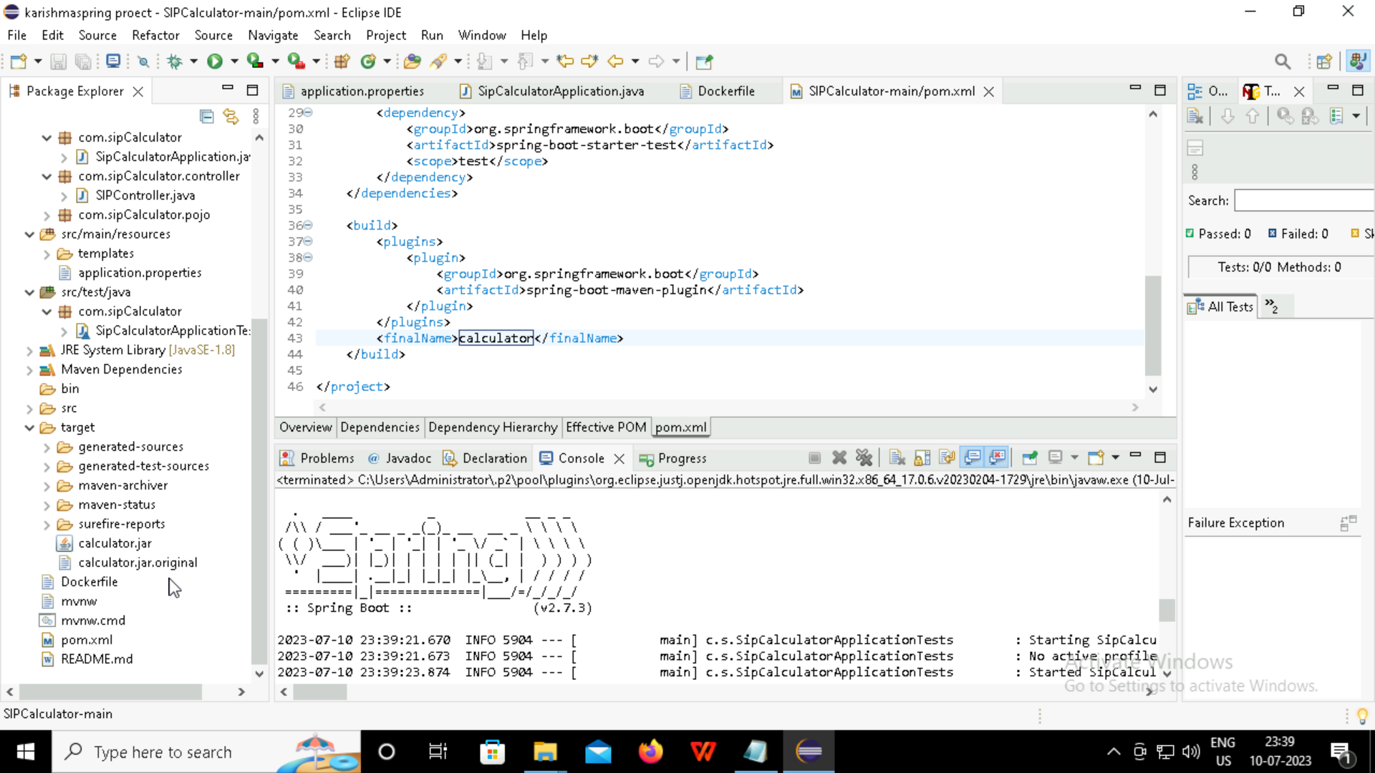

Slide 19
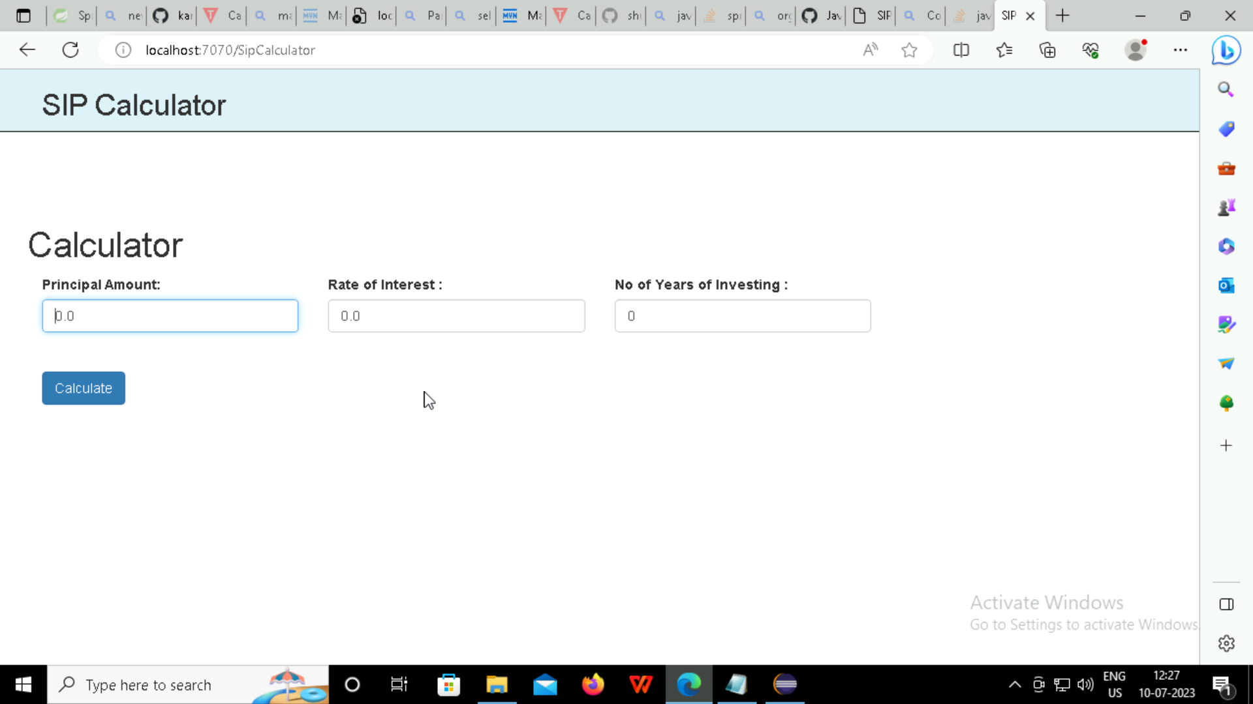

Slide 20
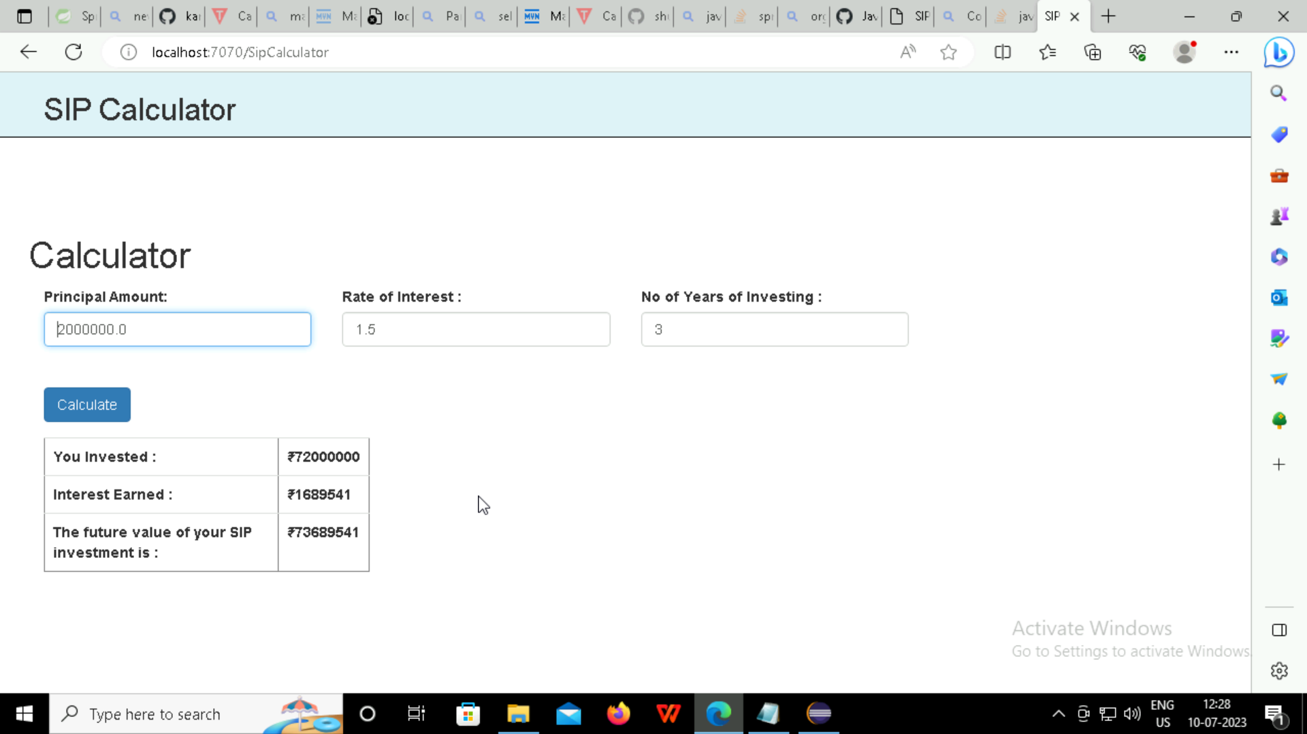

Slide 21
SELENIUM

Slide 22
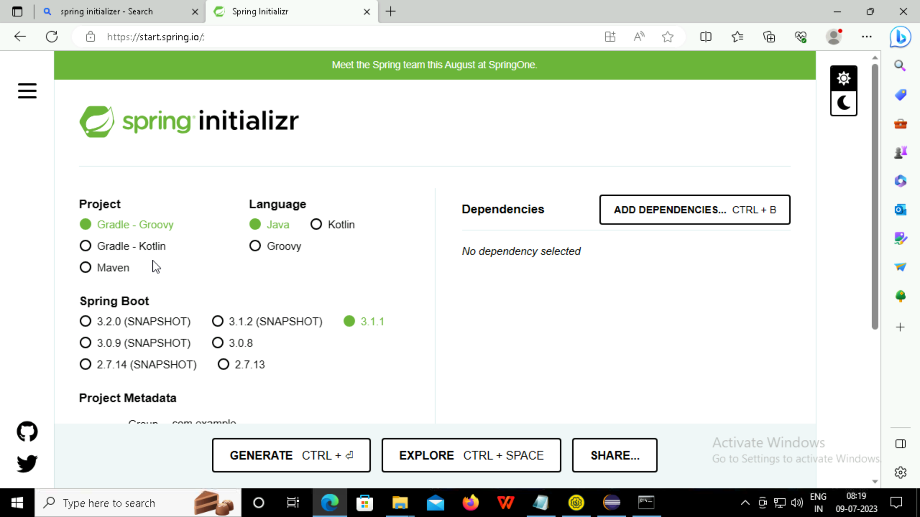

Slide 23
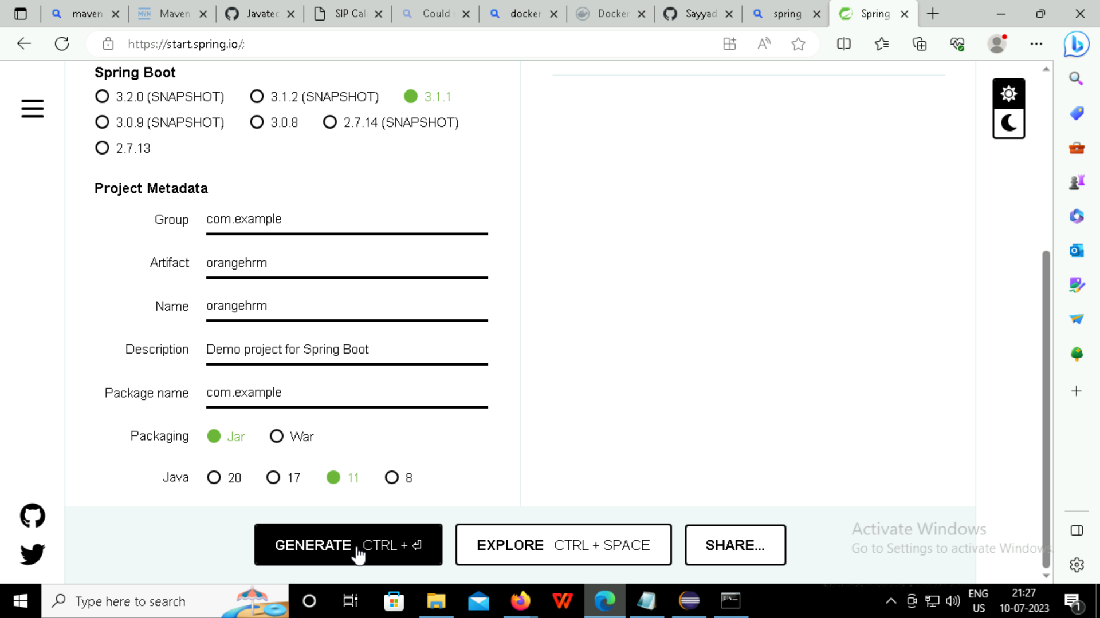

Slide 25
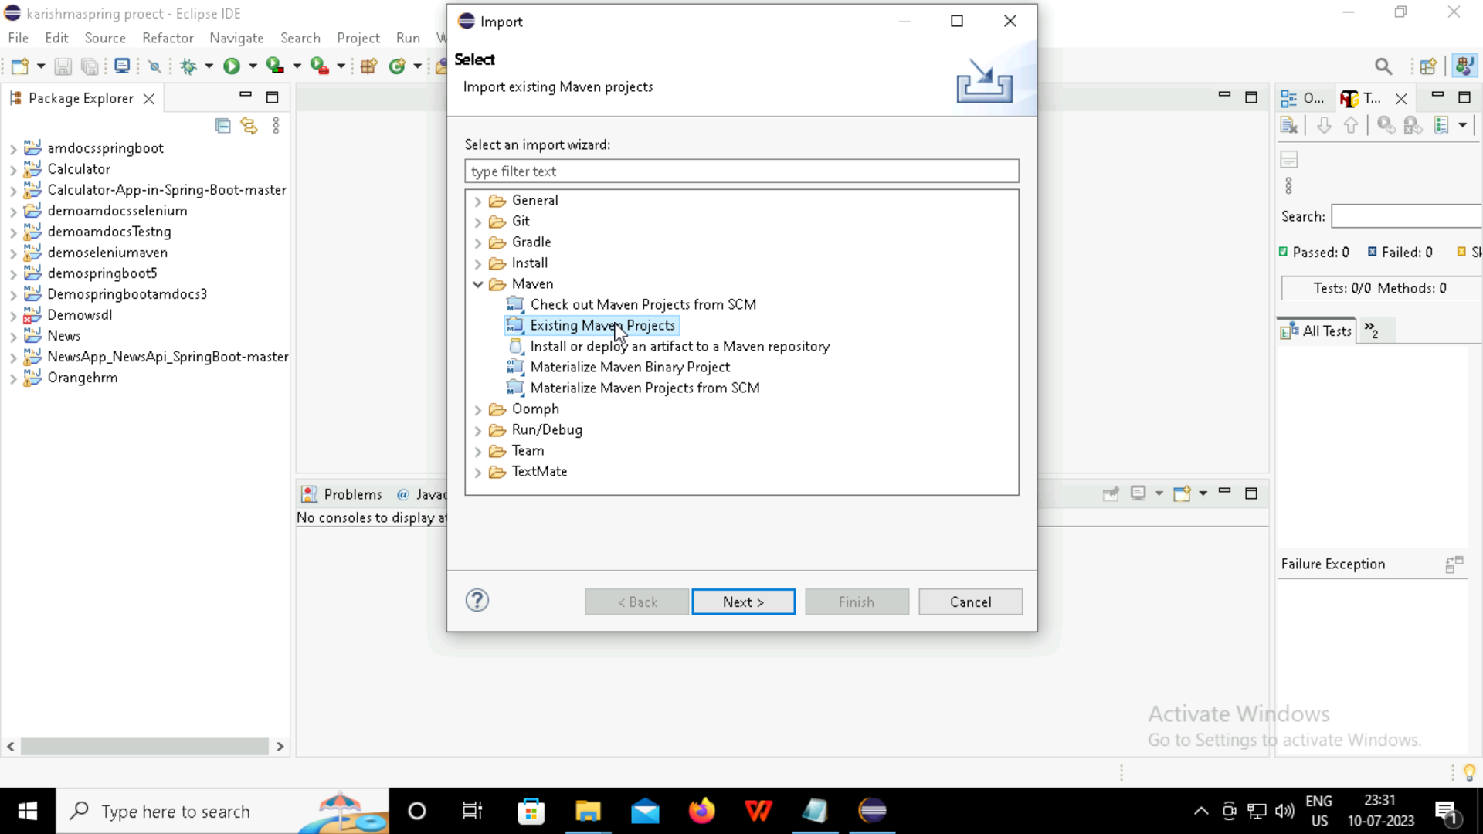

Slide 26
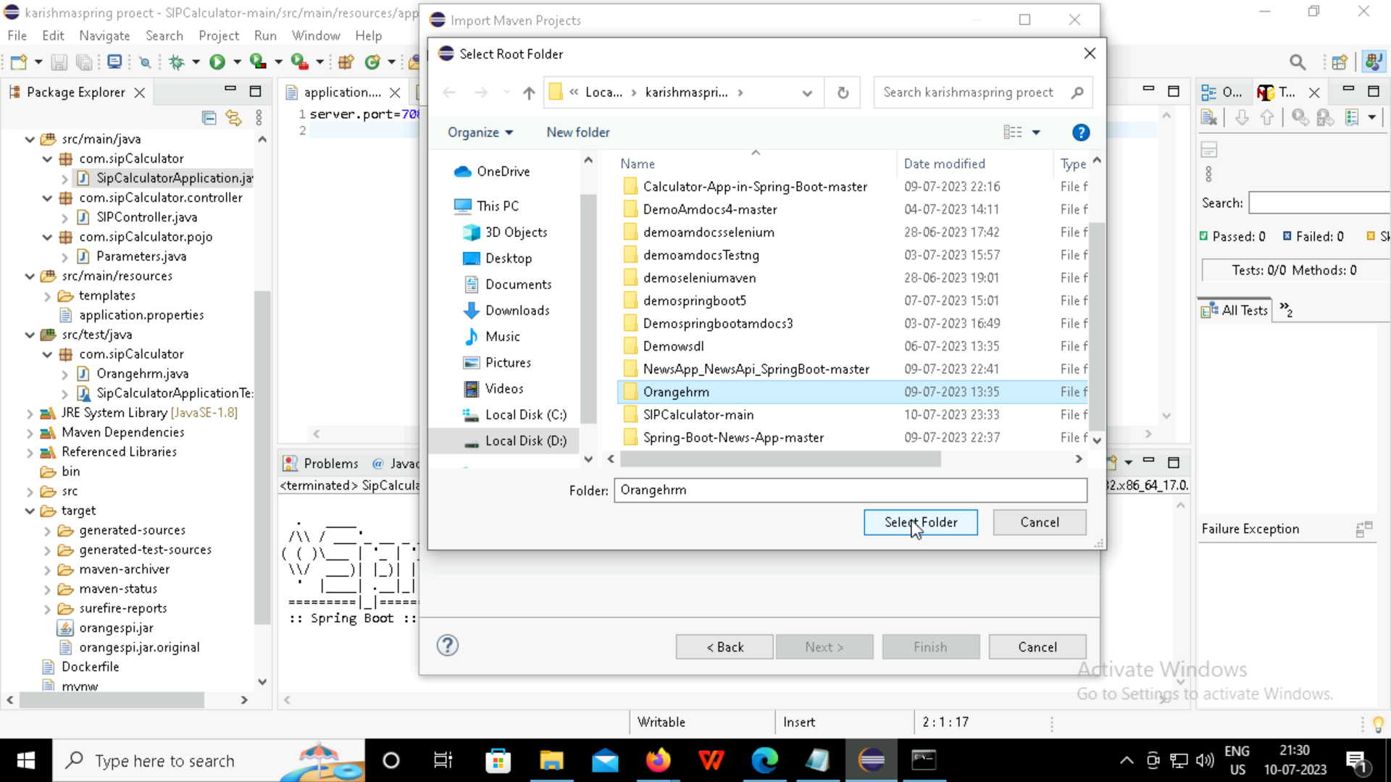

Slide 27
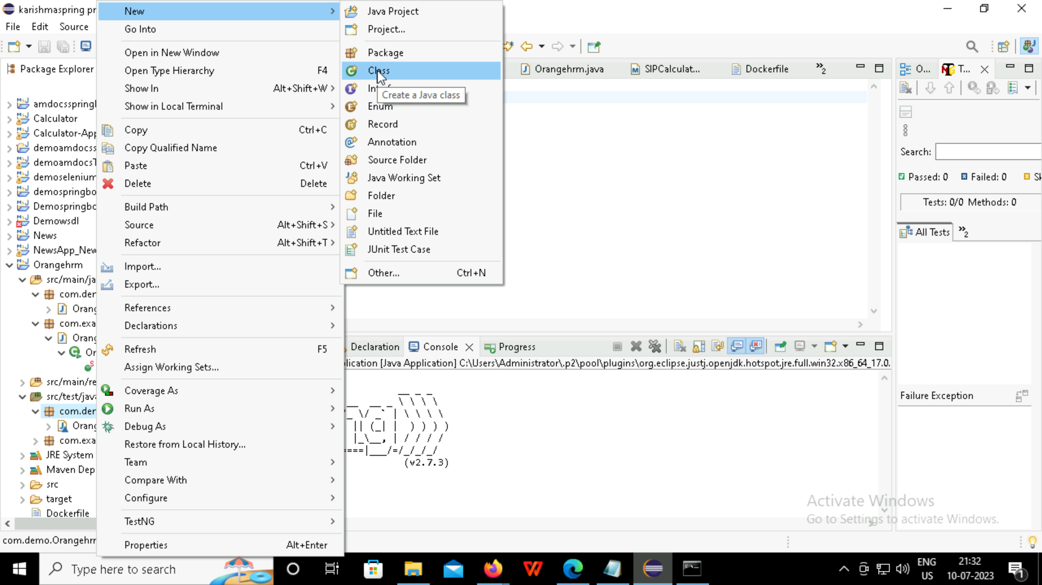

Slide 28
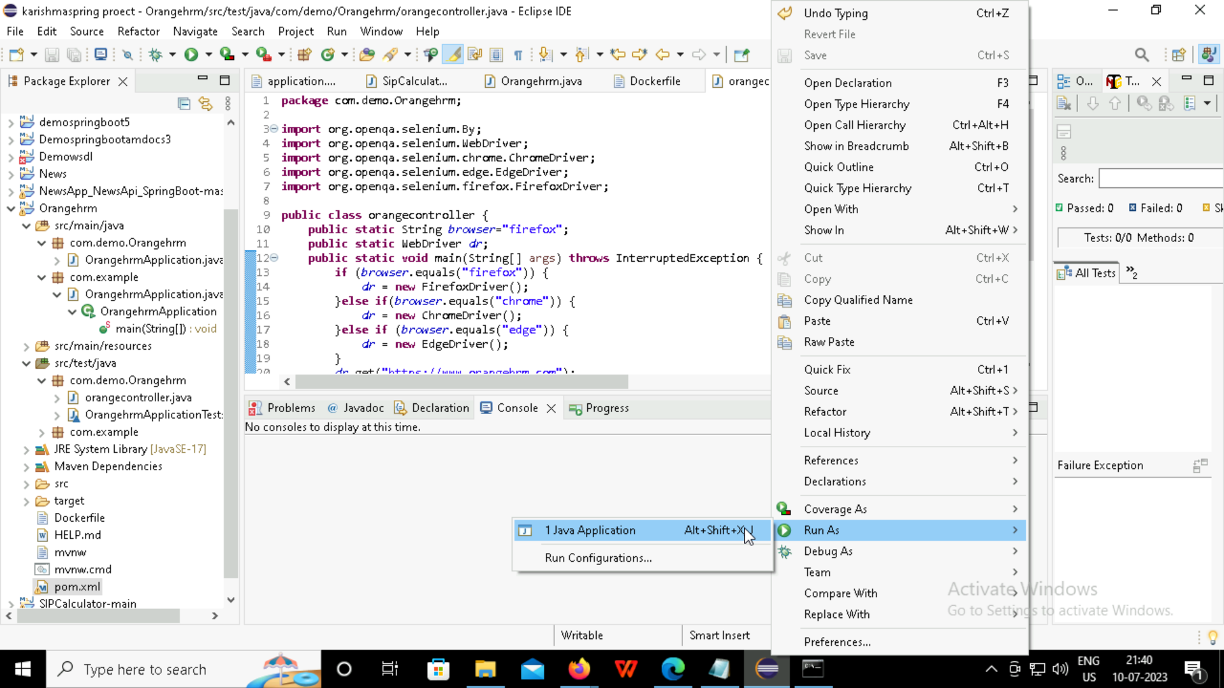

Slide 29
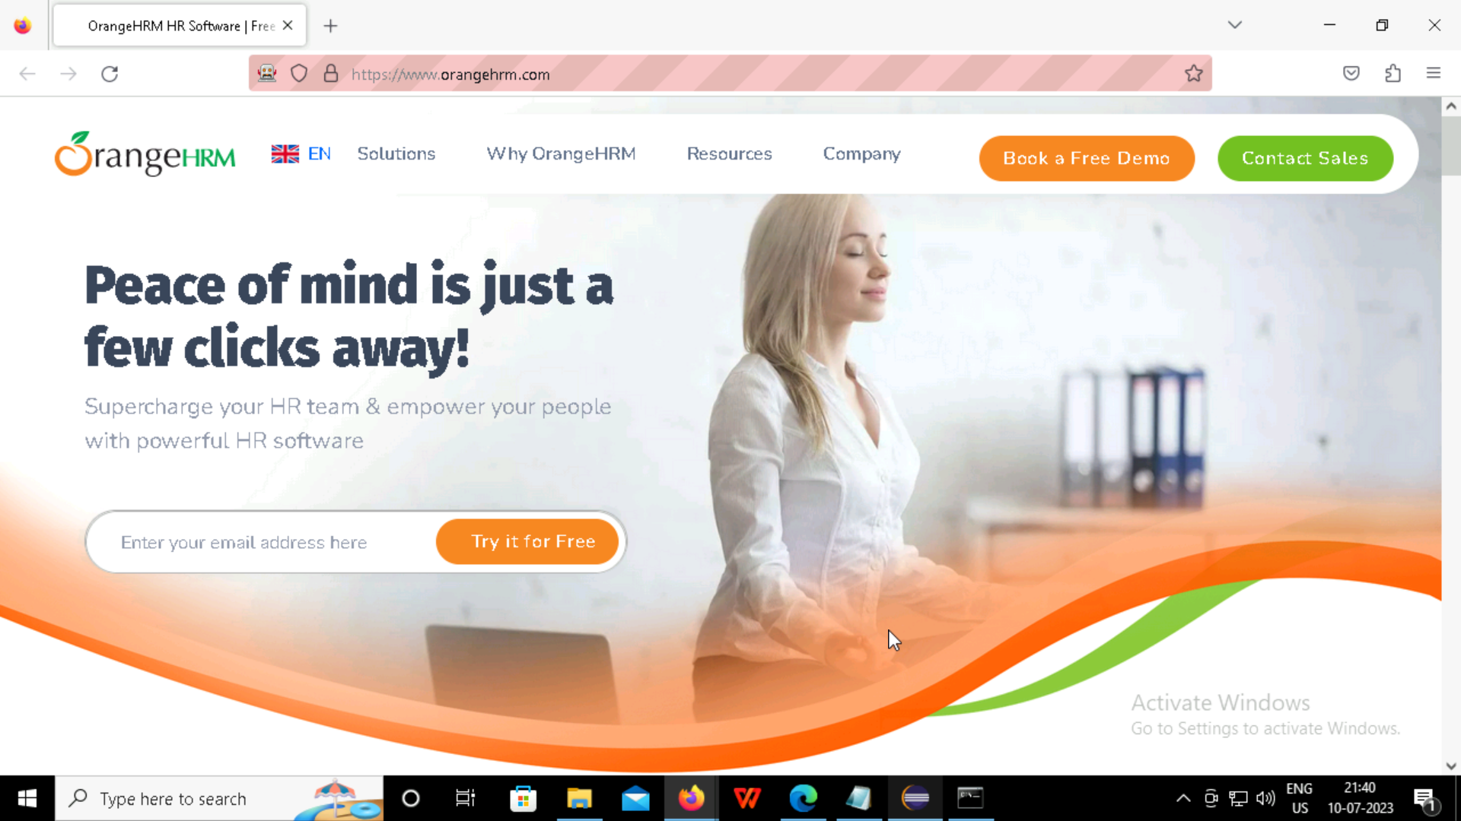

Slide 30
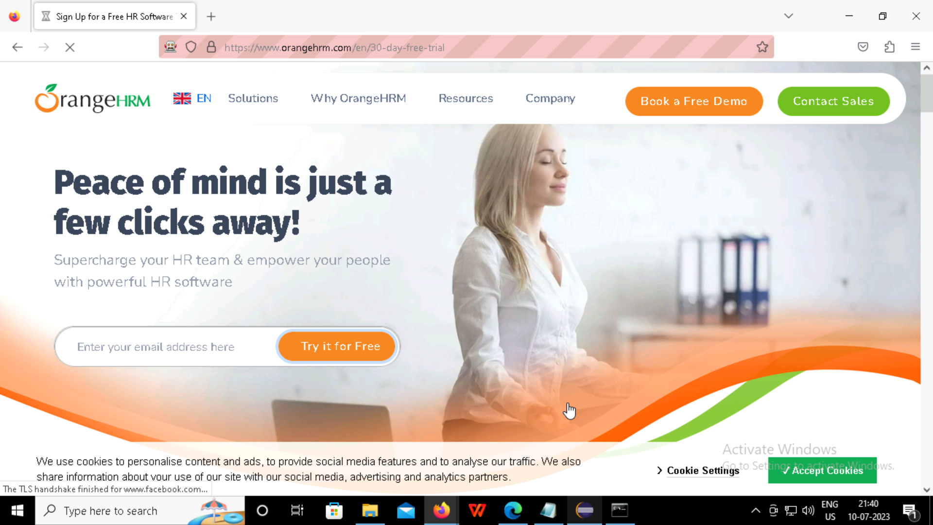

Slide 31
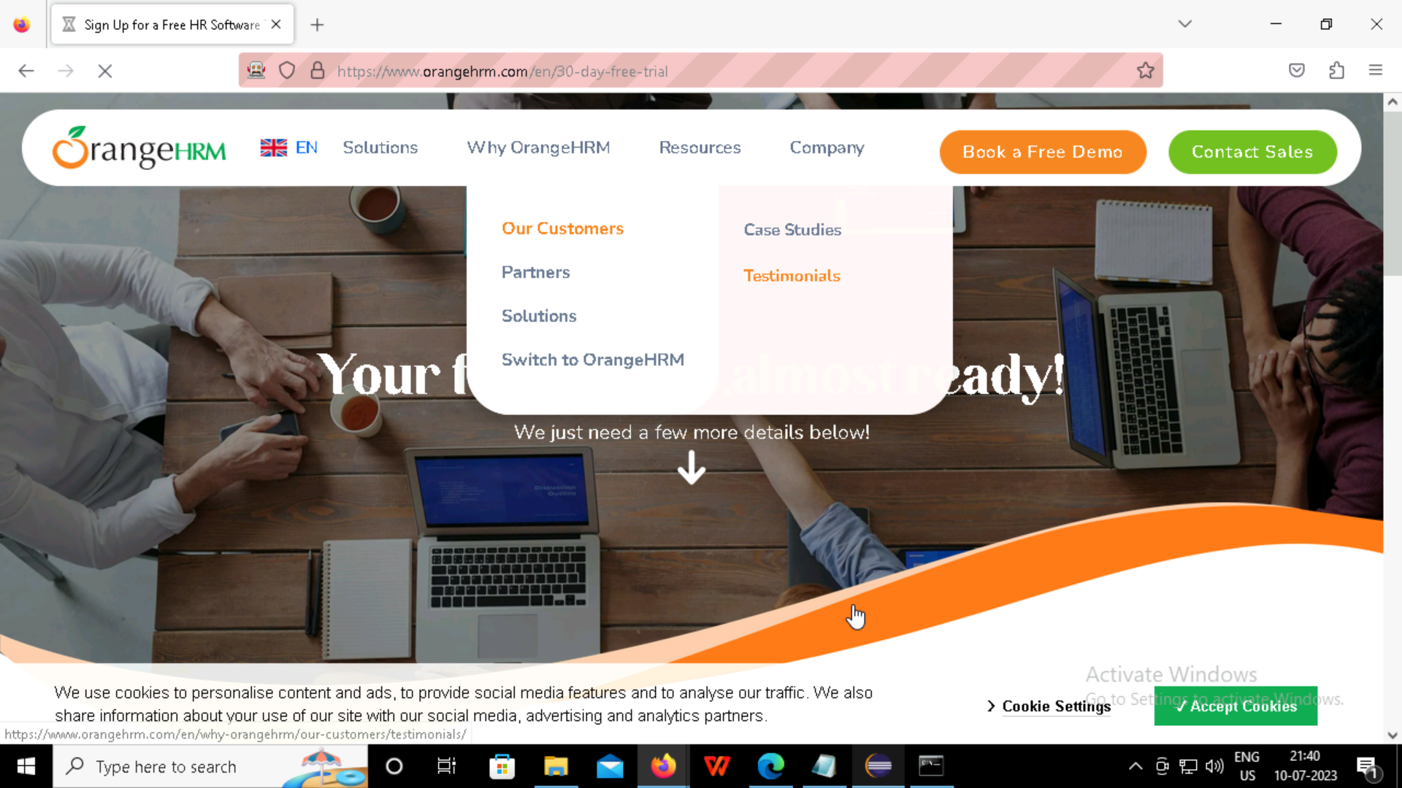

Slide 32
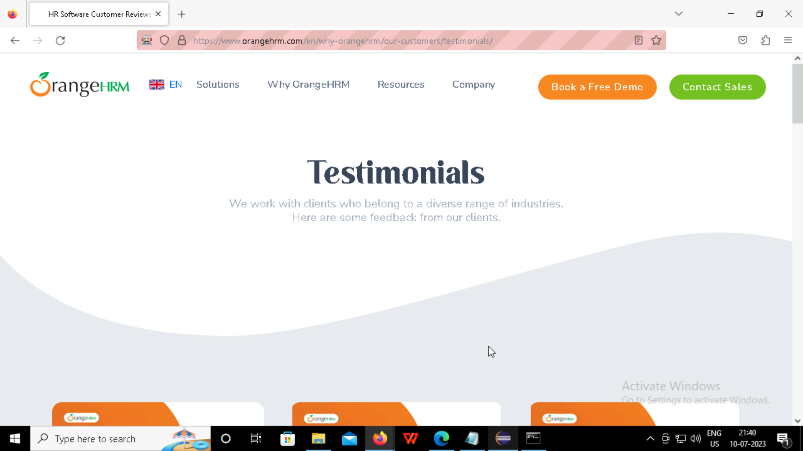

Slide 33
GITHUB

Slide 34
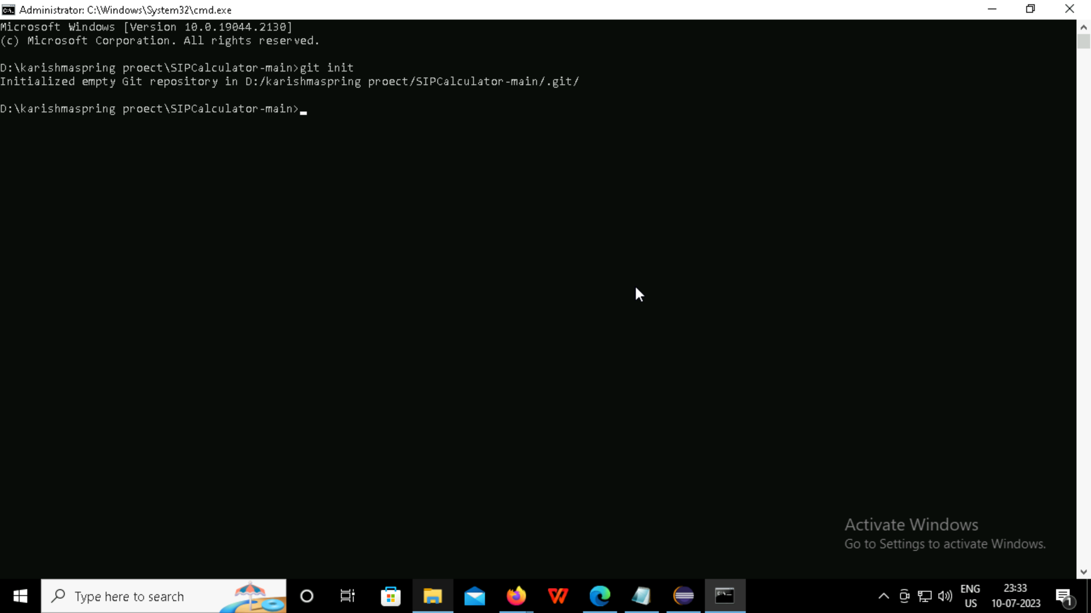

Slide 35
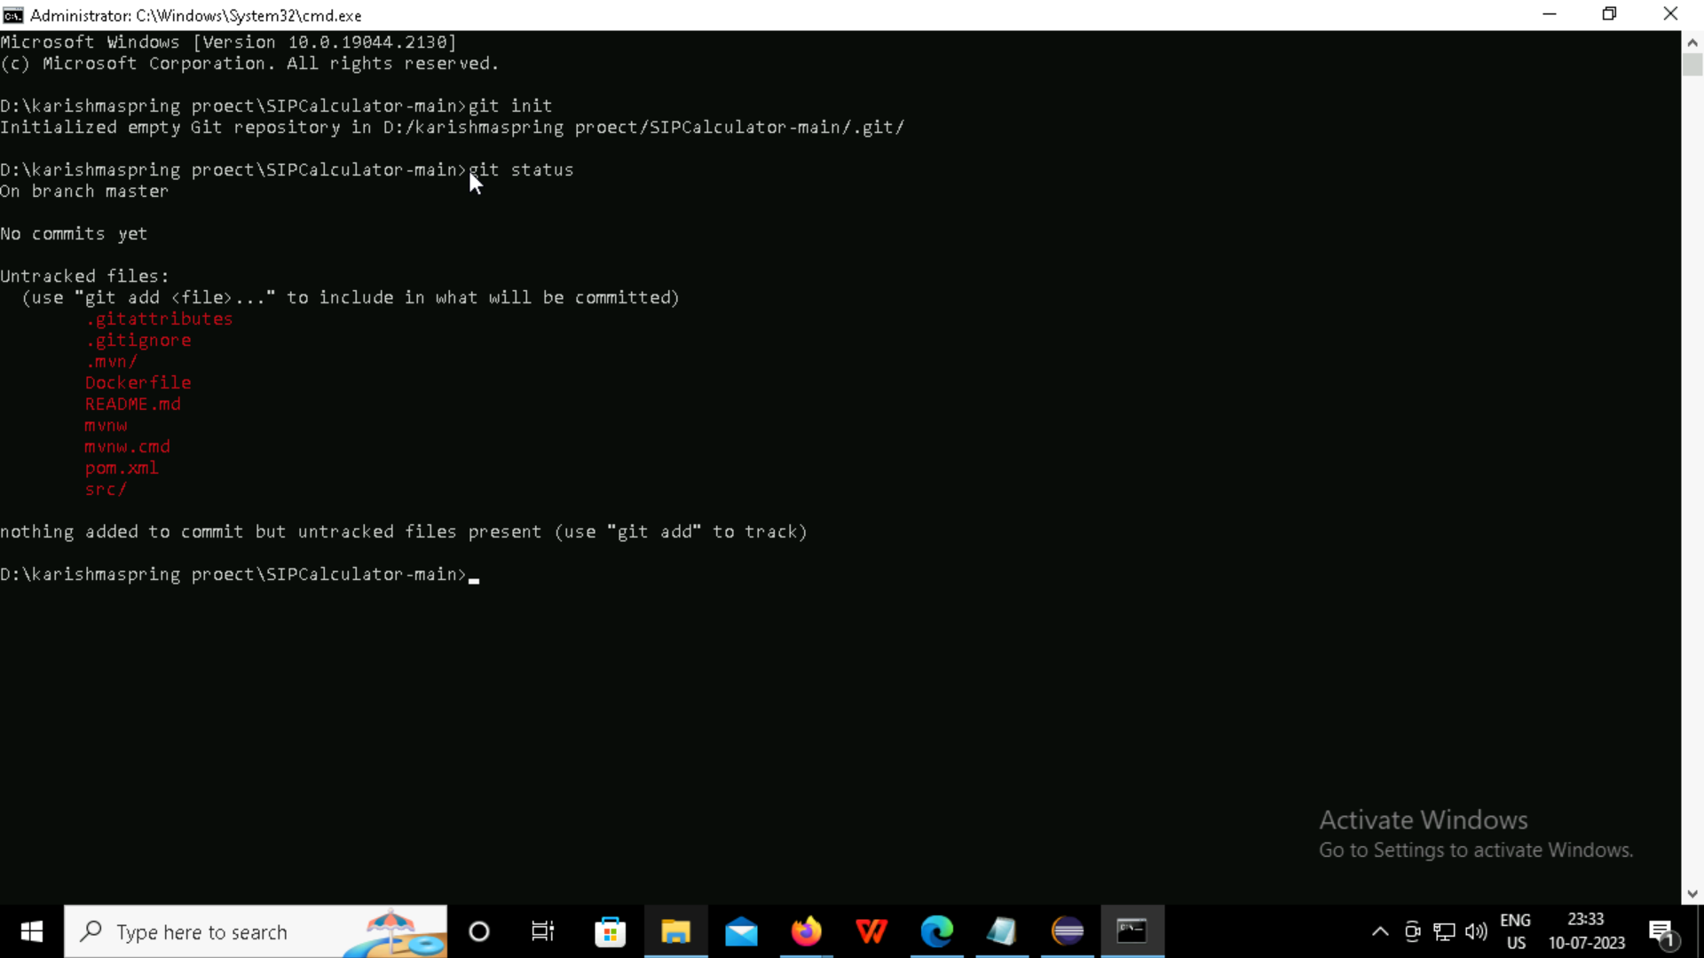

Slide 36
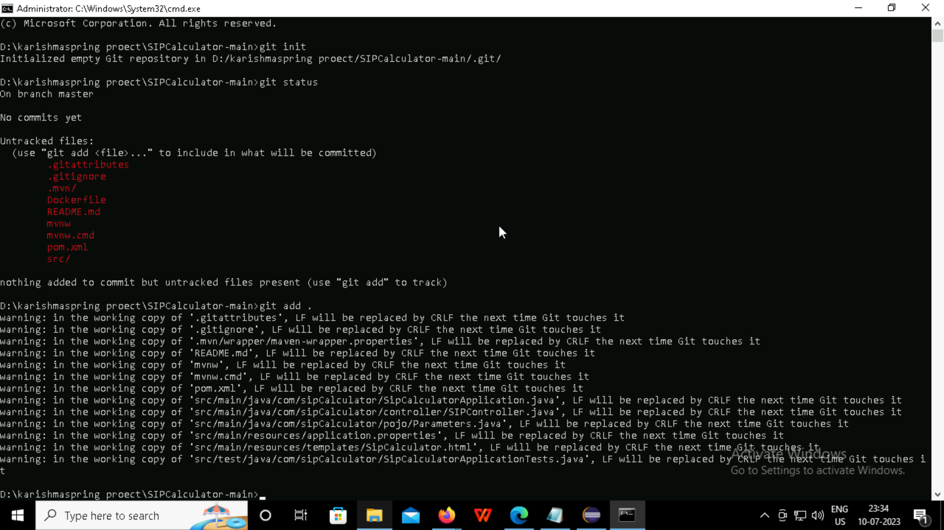

Slide 37
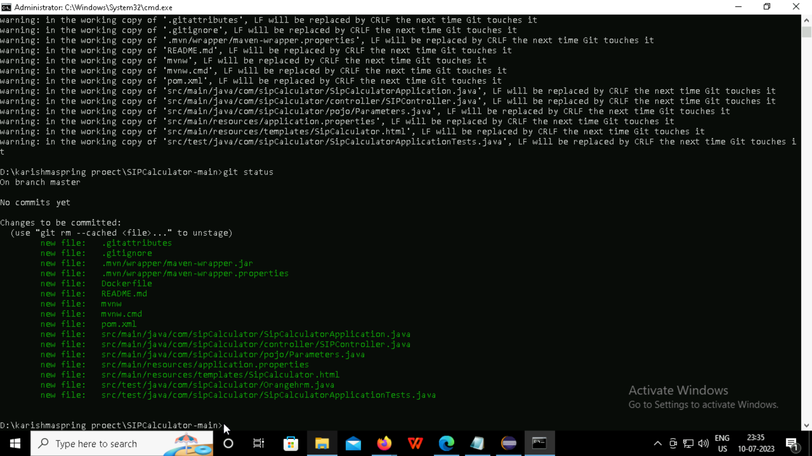
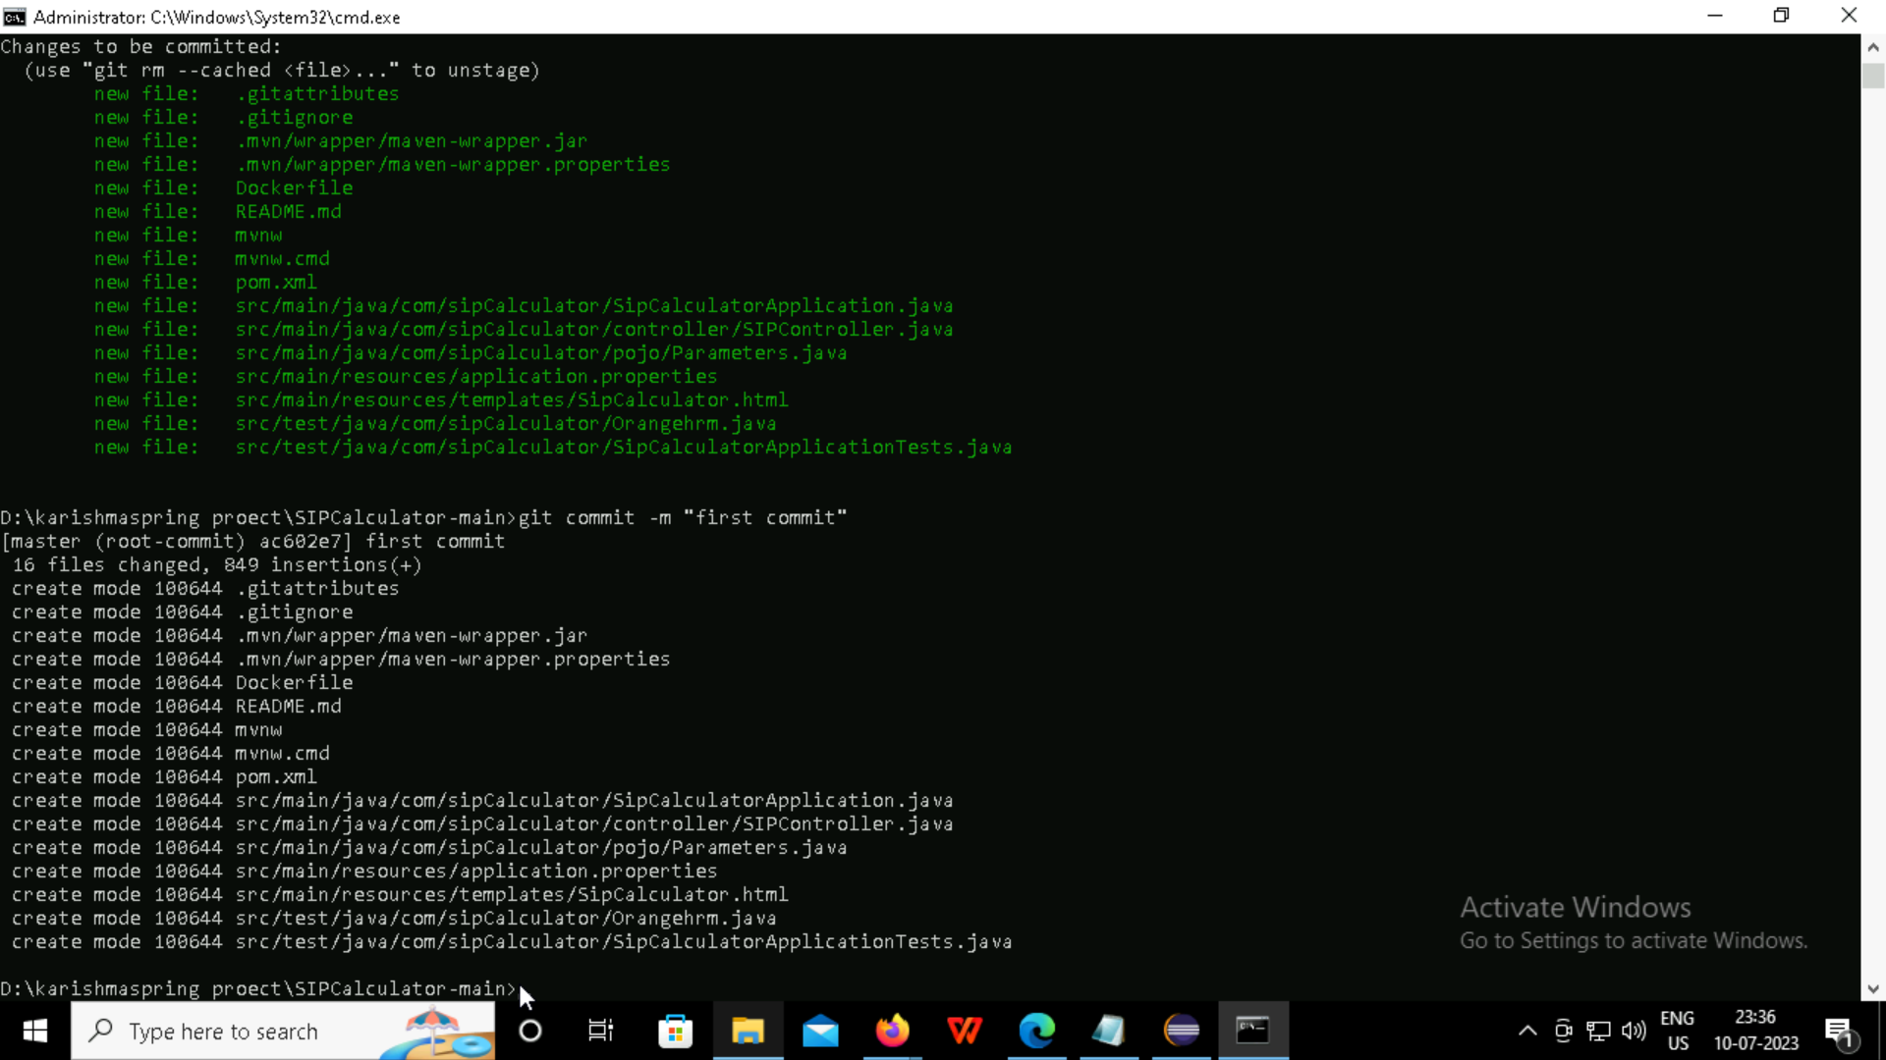

Slide 38
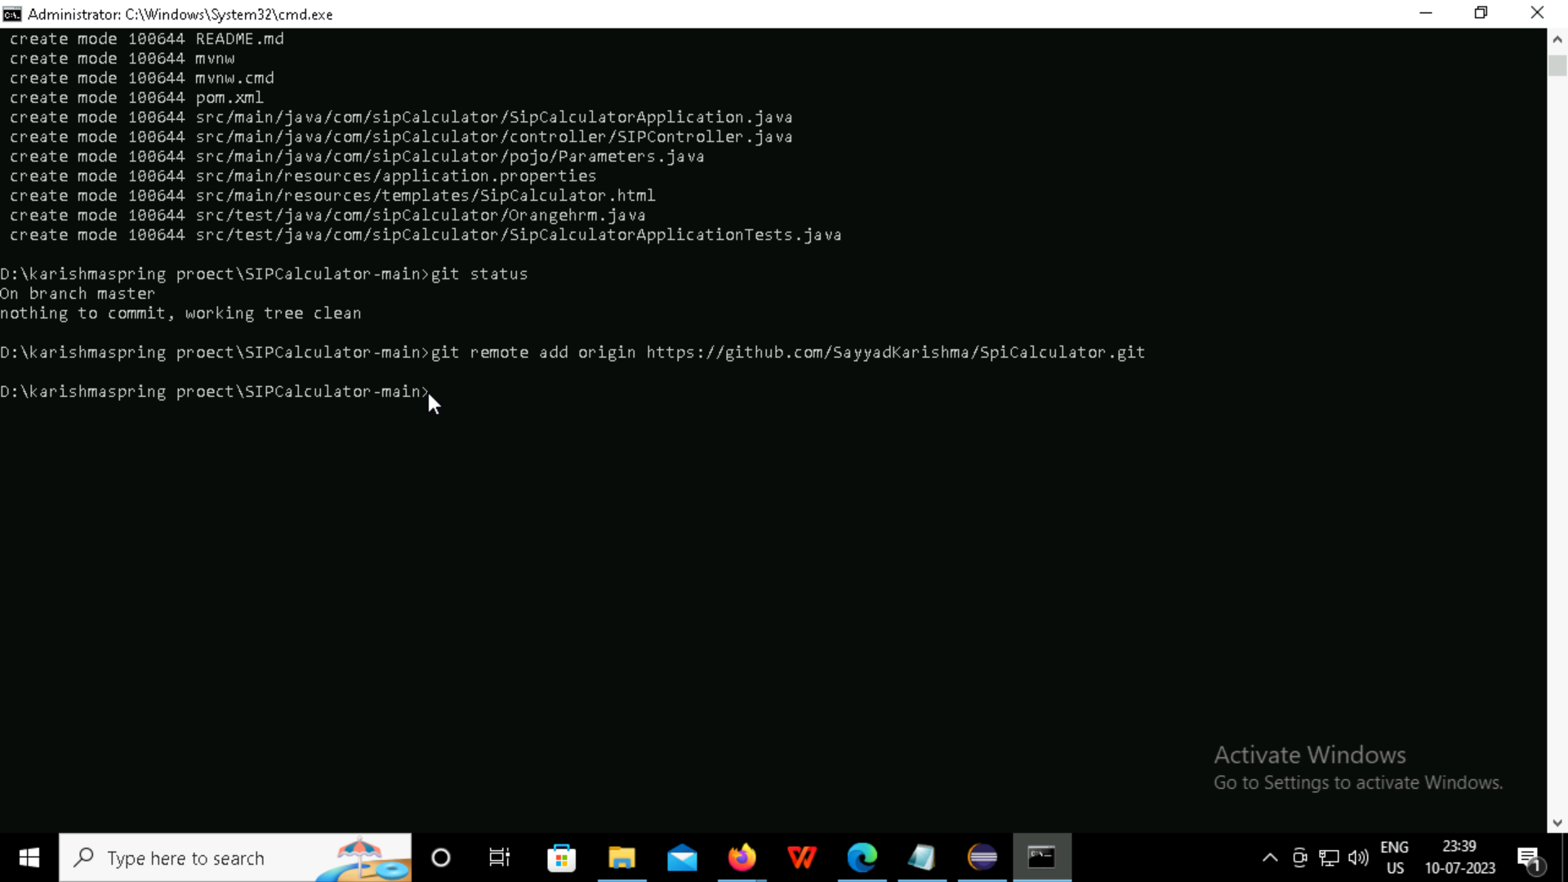

Slide 39
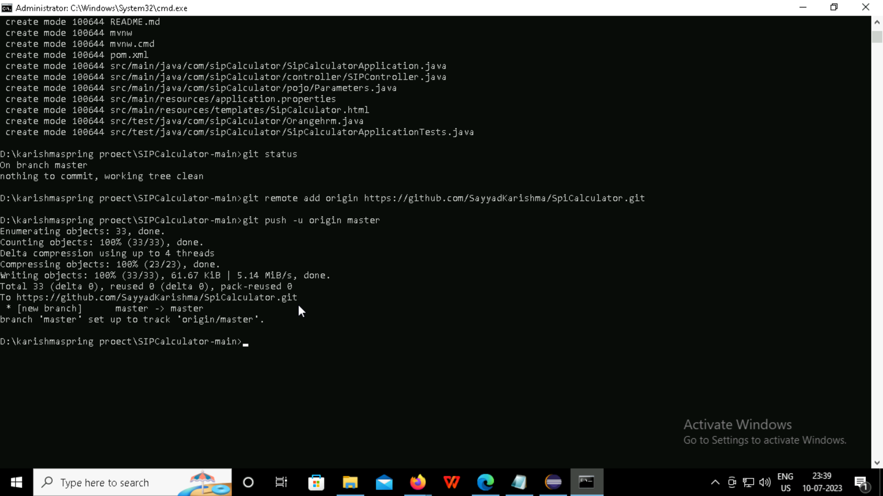

Slide 40
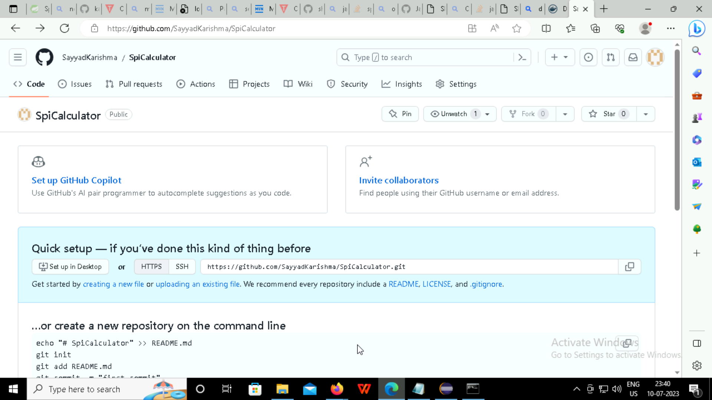

Slide 41
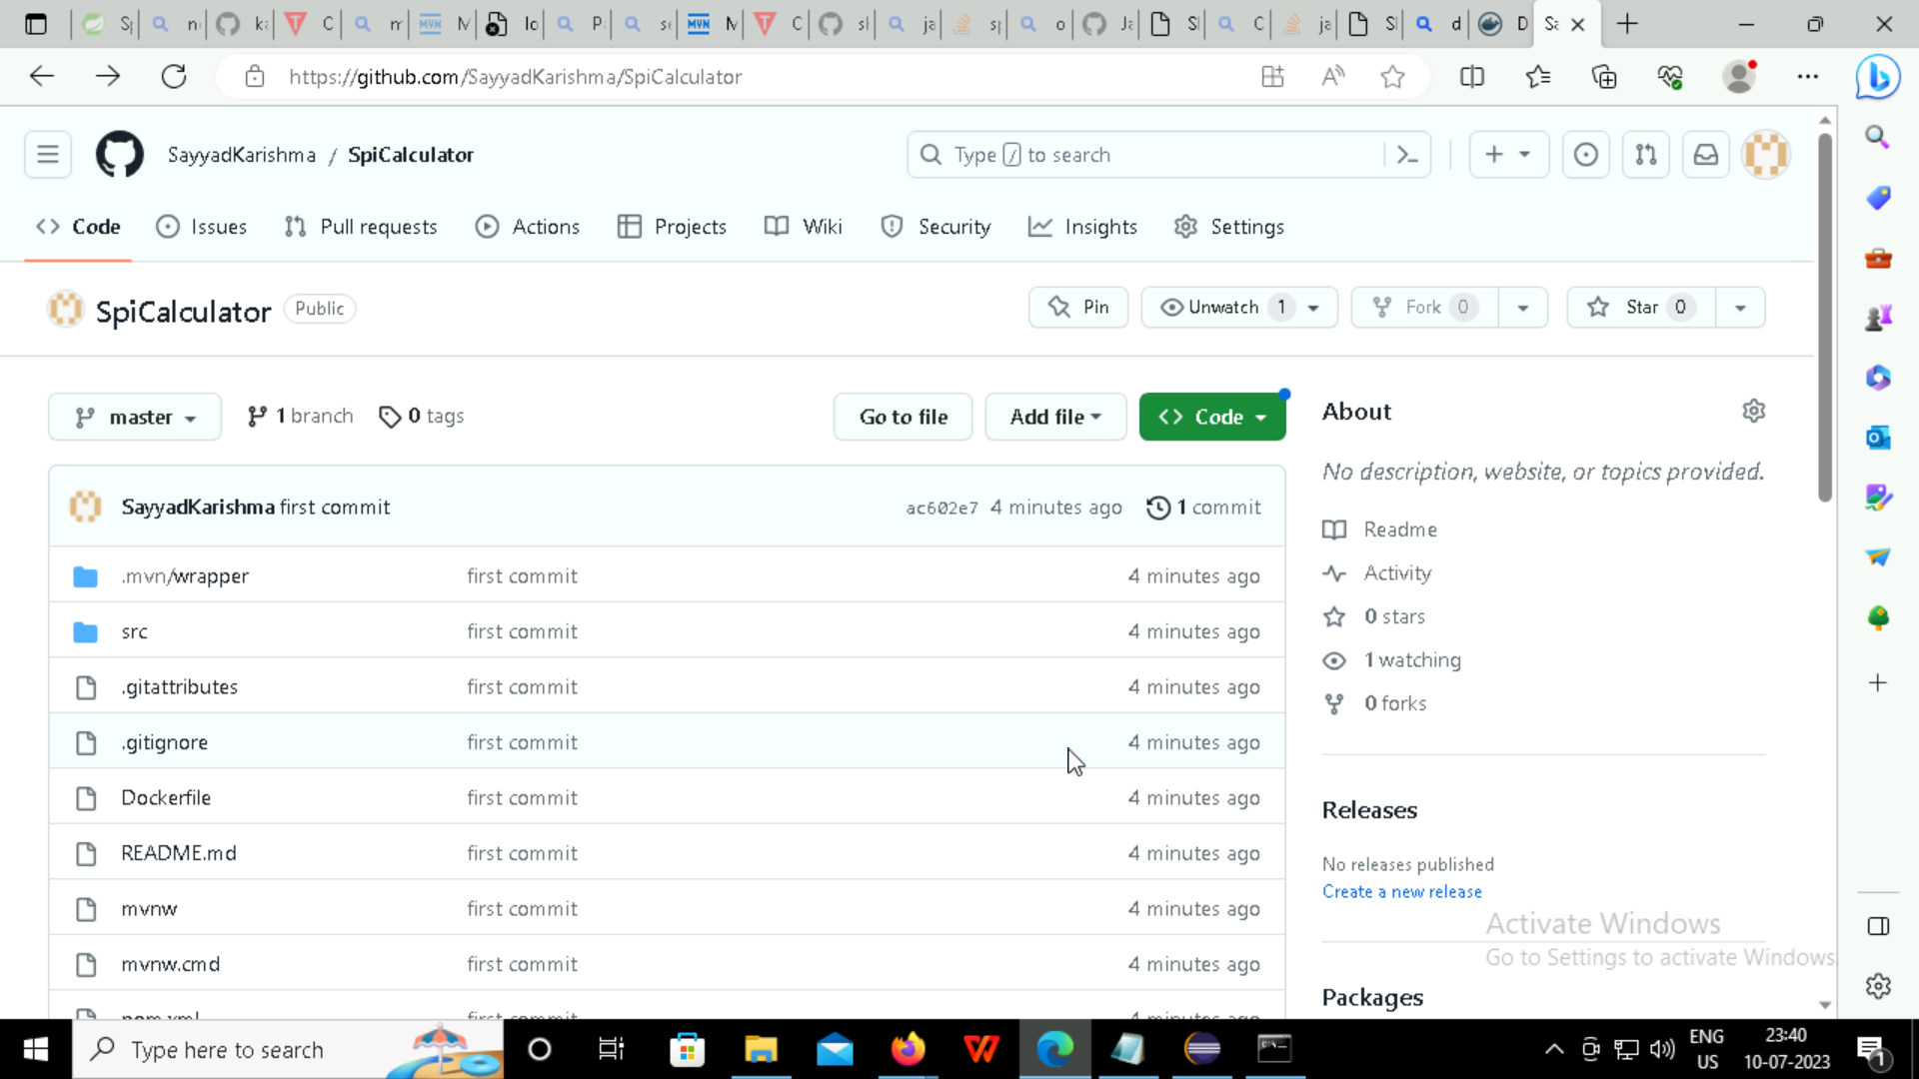

Slide 42
DOCKER HUB

Slide 43
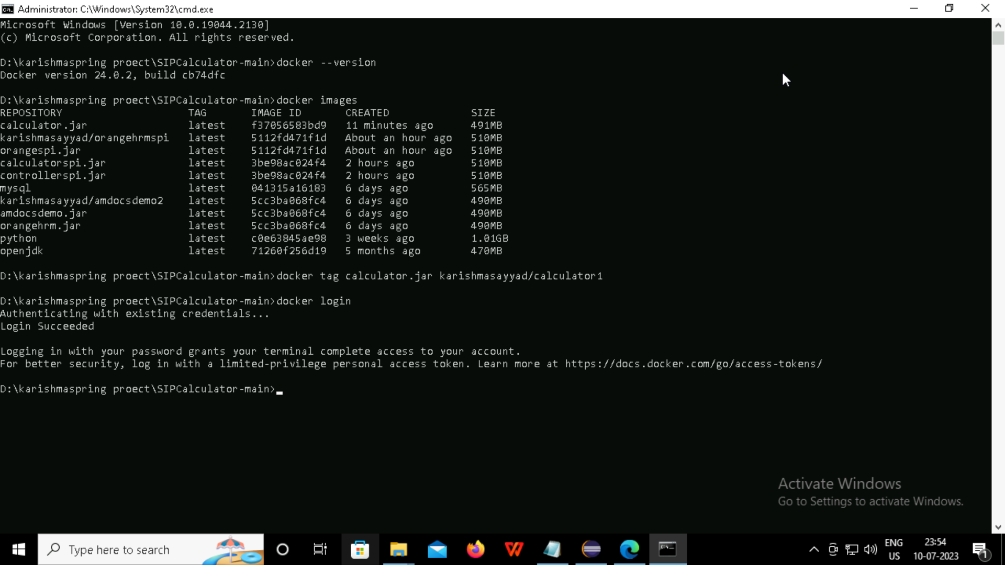

Slide 44
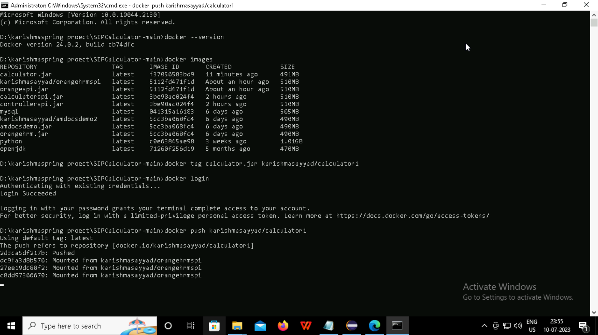

Slide 45
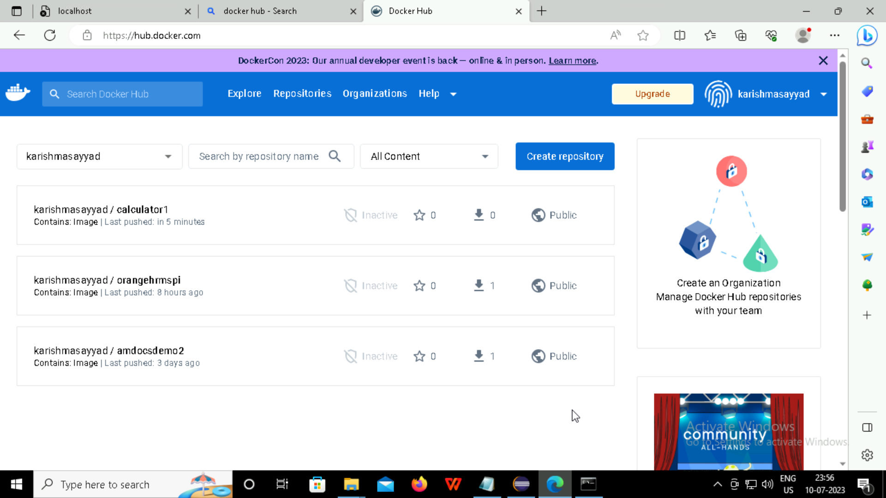

Slide 46

Thank you

